Slide 1
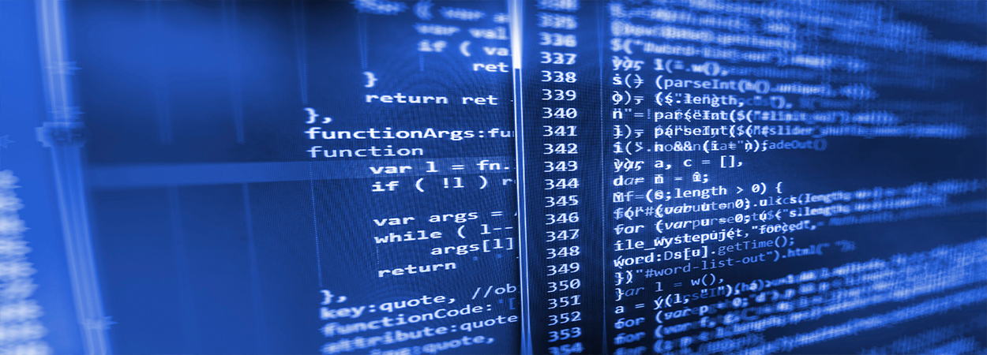
Modelling burn wound healing
Mark de Boer
Ben Dickens

Slide 2
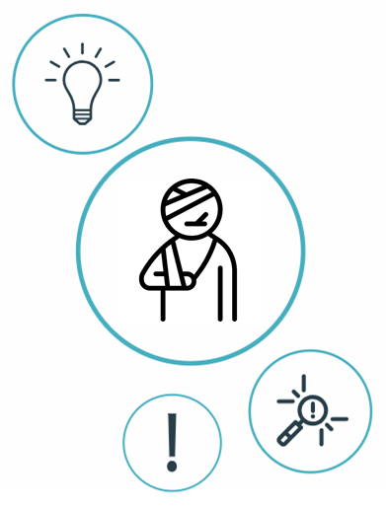
Index
Introduction
Aim
Previously built models
Proposal
Data available?

Slide 3
What is the role of the innate immune system in burn wounds and what is the link with the ABM/contraction models?

Slide 4
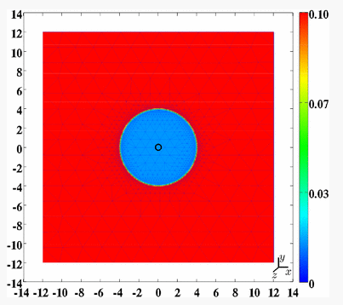

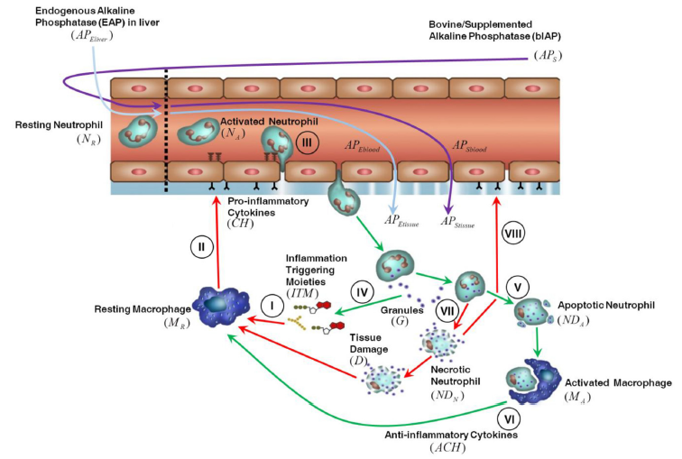
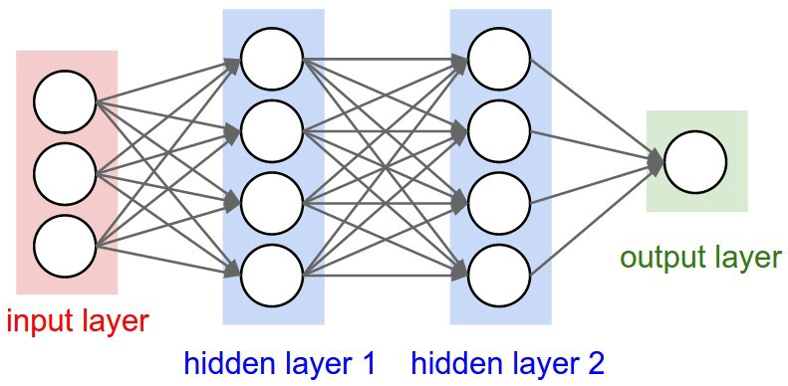
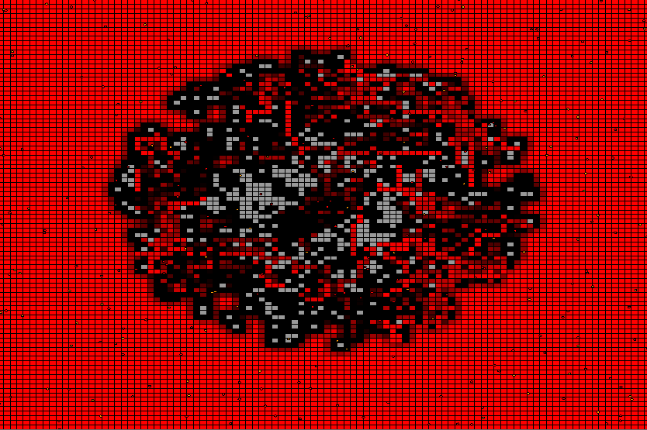
Model Idea
Notes:
Overlapping some are happening in the same time.
Inflammation helps, clear debris and induce the proliferation phase (fibroblasts entering, then angiogenesis), but may lead to tissue damage if it lasts too long. This is often the case when: unable to clear debris, excessive detritus, devitalised tissue, or microbial biofilm is present.

Slide 5
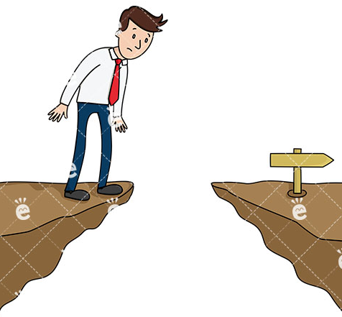

Included cell types
HIIS
Contraction Model
Inflammation Triggering
Moeties (ITMs)
Alkaline Phosphatase
Anti-inflammatory cytokines
Pro-inflammatory cytokines
Relevant cell
populations:
Macrophages
Neutrophils
Granules
Fibroblasts
Myofibroblast population
Generic signaling molecule
Collagen
Notes:
What we might like to consider is grafted or nongrafted skin
Main difference from cuteanous wounds is the the loss of the skin appendages and re-epithelialization, which can only occur from the edges of the wound.
more specific about what happens to the dermis and epidermis (necrosis, ischemia, stem cell hair follicles destroyed, coagulation, ITMs in blood stream etc) during a severe 2nd or 3rd degree burn (especially for AP/immunology expert).

Slide 6
Cells
Endothelial Cells (EC) | Inflammation/ Contraction |  | Influx neutrophils, followed by monocytes/macrophages endothelial cells control the adhesion and migration of inflammatory cells, as well as the exchange of fluid from the bloodstream into the damaged tissue (Allowing white cells to move through blood vessel)
Neutrophils (PMNs) Resting, Activated, Apoptotic, Necrotic | Immune system/ Inflammation/ Contraction | Stem cells in the bone marrow | Recruiting and activating other cells of the immune system Neutrophils play a key role in the front-line defense against invading pathogens. Neutrophils have three methods for directly attacking micro-organisms: phagocytosis (ingestion), degranulation (release of soluble anti-microbials), and generation of neutrophil extracellular traps (NETs). IFN-γ TNF-α IL-1β IL-12 IL-1Ra IL-8
Macrophages – Activated, Resting | Immune system/ Inflammation/ Contraction | Cytokines (by neutrophils) and bacterial endotoxins IFN-γ is the most potent macrophage-activating factor Some cytokines can upregulate the production of cytokines by macrophages (IL-3, IFN gamma) while others can inhibit it (IL-4, IL-10, TGF beta). | Infiltrate after injury in order to clean the wound of bacteria, foreign debris and dead cells. As the tissue begins to repair, the overall macrophage population transitions to one that promotes anti-inflammatory effects (traditionally and collectively referred to as “M2” macrophages), and the migration and proliferation of fibroblasts, keratinocytes and endothelial cells to restore the dermis, epidermis and vasculature, respectively. Activated macrophages also release proteases, neutrophil chemotatic factors; reactive oxygen species such as nitric oxide and superoxide; cytokines such as tumor necrosis factor-alpha (TNF-alpha), interleukin one and eight (IL-1 and IL-8), eicosanoids, as well as growth factors. synthesize and release a large variety of cytokines (IL-1, IL-1ra, IL-6, IL-8, IL-10, IL-12, TNF alpha, IFN gamma, TGF beta)
Fibroblasts | Contraction | Summoned to the wound site via chemoattractants, such as platelet-derived growth factor (PDGF), interleukin-1 beta (IL-1β) and tumour necrosis factor-alpha (TNF-α). migrate into the wound bed via a mechanism called ‘contact guidance’ The fibroblasts migrate along the fibrin-fibronectin plug into the wound site With the subtle difference that the fibroblasts move according to the gradient of TGF-β. The migration of the fibroblasts is also influenced by the orientation of the collagen (This complex ECM matrix supports and regulates the migration and activity of the fibroblasts) | Involved in key processes such as breaking down the fibrin clot, creating new extra cellular matrix (ECM) and collagen structures to support the other cells associated with effective wound healing, as well as contracting the wound. In the presence of transforming growth factor-β, fibroblasts undergo a phenotypical differentiation, whereby the structure and function are altered. stimulate fibroblasts to attach, via integrin containing adhesions, to fibrous proteins in the ECM. This binding causes them to begin to express stress fibres (collagen): At the end of the inflammatory phase and beginning of the proliferative phase (24–48 hours post injury), the first fibroblasts appear at the site of injury. Fibroblasts infiltrate and degrade the fibrin clot by producing various matrix metalloproteinases (MMPs), replacing it with extracellular matrix (ECM) components (collagen) When arrived at wound iste: They begin to proliferate and produce MMPs and other proteinases, such as seperinase, to remove denatured proteins and provisional matrix-associated material not required in the healed wound. These proteinases are tightly controlled by tissue inhibitors of metalloproteinases (TIMPS), which are also produced by fibroblasts. 9 Simultaneously, they also produce new ECM, initially relatively rich in collagen III, fibronectin and hyaluronic acid The fibroblasts and leukocytes will lose activity as time proceeds.
Myofibroblasts | Contraction | Myofibroblasts are characterised by the expression of α-smooth muscle actin (α-SMA), which gives them increased contractile power, as well as cell–matrix and cell–cell adherins, which is in stark contrast to those fibroblasts found in uninjured ECM The exact origin of the myofibroblasts seen in the healing wound is not clear. The majority are recruited locally from the dermis and tissues around the wound site Myofibroblasts have also been shown to express integrin (αvβ3), which allows them to adhere to and migrate on fibrin | Myofibroblasts are responsible for wound closure that occurs in healed acute wounds Myofibroblasts possess bundles of microfilaments which terminate at the cell surface in a specialized adhesion complex, termed the fibronexus or mature local adhesion. This complex bridge the myofibroblast's internal microfilaments with extracellular fibronectin domains thus functioning as a contractile mechanism that enables these cells to generate force to the surrounding extracellular matrix. This contractile force is maintained over time and reinforced by the deposition of collagen Are a consequence of the shortening of the collagen strings by the myofibroblasts?
Alkaline Phosphatase (AP) | Immune system | Alkaline Phosphatases are a group of enzymes found primarily the liver (isoenzyme ALP-1) and bone (isoenzyme ALP-2). There are also small amounts produced by cells lining the intestines (isoenzyme ALP-3), the placenta, and the kidney (in the proximal convoluted tubules). | reduce inflammation by dephosphorylating inflammation triggering moieties like bacterial lipopolysaccharides (LPS) and extracellular nucleotides
Notes:
Wound healing consists of re-epithelialization, contraction and formation of granulation and scar tissue. TGF-β is involved in these events, but its exact roles are not well understood. Here we demonstrate that topical application of a synthetic TGF-β antagonist accelerates re-epithelialization in pig burn wounds (100% re-epithelialization in antagonist-treated wounds vs. ~ 70% reepithelialization in control wounds on postburn day 26) and reduces wound contraction and scarring in standard pig skin burn, pig skin excision and rabbit skin excision wounds.

Slide 7
Fibers
Collagen | Contraction | Fibroblasts Since it is known that diffusion in the fibrin is slower than in the collagen network | Collagen repairs tissue damage Collagen fragments are chemotactic to neutrophils and macrophages
Fibrin/Fibronectin | Contraction |  | Migration Fibroblasts and Macrophages This fibrin-fibronectin plug is also the main structural support for the wound until collagen is deposited
Elastin | Contraction | Fibroblasts | Together with Collagen in new ECM

Slide 8
Growth Factors
PDGF | Contraction | Released form platelets early upon activation Macrophages Fibroblasts | Stimulates collagen synthesis Attractant leukocytes (stimulates chemotaxis, proliferation, and new gene expression in monocytes-macrophages and fibroblasts)
TGFB | Contraction | Released form platelets early upon activation Macrophages Fibroblasts | Chemotactic to neutrophils, macrophages and fibroblasts Inhibit expression of TNF-α in neutrophils, macrophages and fibroblasts Inhibit expression of IL-1β in macrophages (minimal effect) Activate resting fibroblasts Stimulates resting monocytes – upregulates inflammatory response Mitogenic to fibroblasts (proliferation) Stimulate collagen synthesis in fibroblasts inhibits activated macrophages fibroblast migration, maturation and ECM synthesis

Slide 9
Pro-Inflammatory cytokines
INF- γ | Inflammation/ Remodeling | Predominantly by natural killer (NK) and natural killer T (NKT) cells T helper cells (specifically, Th1 cells), cytotoxic T cells (TC cells), macrophages, mucosal epithelial cells | Its predominant effects include resident macrophage and neutrophil activation in order to increase cytotoxicity, and an intensification of the local inflammatory response by increasing IL-1β, NO, and TNF-α production in macrophages. IFN-γ furthermore plays an important role in the remodeling of wound tissues; where overproduction of this factor locally can decrease wound contraction and collagen synthesis (reduces the number of myofibroblasts)
TNFa | Inflammation | Neutrophils Monocytes Fibroblasts | Chemotactic to neutrophils and macrophages Activate macrophages Stimulate expressions of TNF-α, IL-1β, IL-6 and IL-8 in macrophages Mitogenic to fibroblasts (proliferation) Stimulate expression of IL-6 in fibroblasts Stimulate expression of MMP-8 in neutrophils
IL-1β | Inflammation | Platelets Macrophages Neutrophils | Chemotactic to neutrophils and macrophages Activate macrophages Stimulate expressions of TNF-α, IL-1β, IL-6 and IL-8 in macrophages Mitogenic to fibroblasts (proliferation) Inhibit collagen synthesis in fibroblasts
IL-6 | Inflammation | Macrophages Fibroblasts | Chemotactic to neutrophils Stimulate collagen synthesis in fibroblasts reduces the production of fibronectin, albumin, and transferrin Production of neutrophils in the bone marrow. It supports the growth of B cells and is antagonistic to regulatory T cells.
IL-8 | Inflammation | Macrophages Fibroblasts Epithelial cells | Inhibit collagen synthesis in fibroblasts Chemotactic to neutrophils (but also other granulocytes, causing them to migrate toward the site of infection) A potent promoter of angiogenesis

Slide 10
Anti-inflammatory cytokines
IL-4 | Inflammation | Initial producer unknown TH2 cells (positive feedback) | Promotes transition of TH0 cells to TH2 cells. IL-4 decreases the production of Th1 cells, macrophages, IFN-gamma, and dendritic cell IL-12. The presence of IL-4 in extravascular tissues promotes alternative activation of macrophages into M2 cells and inhibits classical activation of macrophages into M1 cells. An increase in repair macrophages (M2) is coupled with secretion of IL-10 and TGF-β that result in a diminution of pathological inflammation. Release of arginase, proline, polyaminases and TGF-β by the activated M2 cell is tied with wound repair and fibrosis
IL-10 | Inflammation | Macrophages TH2 cells | Inhibit activation of neutrophils and macrophages Inhibit expression of TNF-α in neutrophils, macrophages and fibroblasts Inhibit expression of IL-1β and IFN-γ in macrophages Inhibit expressions of IL-6 and IL-8 in macrophages and fibroblasts Stimulate expression of TGF-β in macrophages and fibroblasts Stimulate expression of IL-10 in macrophages Inhibit activated neutrophil survival (migration and apoptosis)

Slide 11

Create a validated computational model of one or more stages of burn wound healing, that is linked to the HIIS model (co-evolution governed by exposure to blood supply).
Notes:
What causes a better healing of burn wounds?
Model the healing process to
investigate how all agents are influencing each other

Slide 12

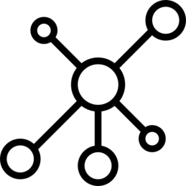
Previously built models
Dynamic computational frameworks simulating
separate burn/cutaneous wound healing stages:
Inflammation
Contraction/Remodeling
Angiogenesis
Dynamic computational Alkaline Phosphatase (AP) related innate immune system model.
Notes:
Perfect skin regeneration of burn wounds remains a challenge. There is still a lack of fundamental understanding of the interactions between different cell types, complex cell signalling networks and mechanical feedback loops during the wound healing process. Previous efforts have focused on constructing dynamic computational frameworks simulating cutaneous wound healing [1,2,3], but have not focused on burn wound healing.
In addition, dynamic computational models have been used to study the inflammation process in wound healing. Presbitero et al. [4] constructed a validated numerical systemic inflammation model under clinical treatment conditions of the Alkaline Phosphatase enzyme. Alkaline phosphatase (AP) exhibits anti-inflammatory effects by dephosphorylating inflammation triggering moieties (ITMs) like bacterial lipopolysaccharides and extracellular nucleotides.
These models are all not burn wound specific, therefore adjustments or an expansion of these models are demanded, to simulate the burn wound procedure. The link between the AP model and the cutaneous wound healing models, has not been investigated/found yet. By first performing a literature review focused on possible connections, this will be investigated. Constructing a computational model simulating burn wound healing would be a step forward towards a better understanding of dynamical adaptation to heal burn wounds.
ABM: simulating the actions and interactions of autonomous agents (both individual or collective entities such as organizations or groups) with a view to assessing their effects on the system as a whole

Slide 13
Tepole et al. ~
Computational modeling of chemo-bio-mechanical
Coupling toward
wound healing
Flegg et al. ~
On the mathematical modeling of wound healing angiogenesis
Boon et al. ~
A multi-agent cell-based model for wound contraction
Li et al. 2011 ~ Biosimulation of Acute Phonotrauma: an Extended Model
2011
2014
2015
2016
2007
2013
2017
2018
Mi et al. ~
Agent-based model of inflammation and wound healing
Ziraldo et al. ~
Computational Modeling of Inflammation and Wound Healing
Tepole et al. ~
Computational systems mechanobiology of Wound Healing
Sloot et al. ~
Alkaline Phospatase and it’s role in the Immune System
Notes:
All models talk about validated models of different phases but not linked to the immune system model because came out in 2018. we only need the link

Slide 14
Sloot et al. 2018 ~ Alkaline Phospatase and it’s role in the Immune System
Simulates innate immune system
Models systemic insult (massive amount of ITMs) from multiple sources
Compartmentalized into: liver, blood stream, and tissue
Healing phases are dependent on the preceding spatio-temporal action of the IS
AP model is already sufficient to predict/protect against organ damage.
Notes:
This paper and therefore the “tissue” represents the entire body. It is. For severe burns, and the minimisation of scarring, we most likely need to introduce a cell agent based model that is coupled to the HIIS model. There are several interlinked phases of burn wound healing, each phase of the process is dependent on the preceding spatio-temporal action of the IS. E.g. the ECM cannot be remodelled until there has been sufficient angiogenesis.
suggests ATP and H202 may establish a pro-inflammatory permissive environment to potentiate the recruitment of immune cells into the inflamed tissue. Some evidence that atp enhances response to attractant by generating a signal amplification loop

Slide 15
Inflammation Triggering
Moeties (ITMs)
Alkaline Phosphatase
Anti-inflammatory cytokines
Pro-inflammatory cytokines
Relevant cell
populations:
Macrophages
Neutrophils
Granules
Notes:
To the best of our
knowledge this is the first numerical model of a complex innate
immune response that is quantitatively validated with clinical
data. Our work paves the way to a deeper understanding of the
immunological mechanisms underpinning this important
innate immune response to oxidative stress mediated
inflammation.

Slide 16
Li et al. 2011 ~ Biosimulation of Acute Phonotrauma: an Extended Model
2-Dimensional ABM model
Inflammation + synthesis of collagen/elastin (link to contraction)
Relevant cell populations:
Platelets
Macrophages
Neutrophils
Fibroblasts
Fibres:
Collagen
Elastin
Key effector cytokines :
TNF-α
IL-1/6/8/10
TGF-β1
bFGF
Notes:
Probelm of equation is that it doesnt take into account spatoi temproal
Agents as cells cytokines
Specific refer to cytokines and kinked it to collagen

Slide 17
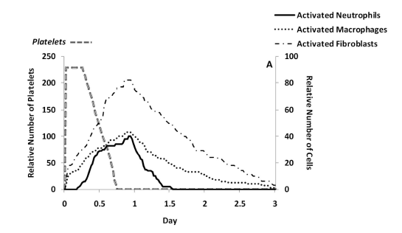
Connected Cytokines to Fibers
Predicted cell trajectories for platelets, activated neutrophils, activated macrophages and activated fibroblasts.
Predicted ECM trajectories for new collagen and elastin
Notes:
Hyaluronan (volgens oudere nomenclatuur ook hyaluronzuur of hyaluronaat genoemd) is een glycosaminoglycaan dat veelvuldig in bindweefsel, epitheelweefsel en zenuwweefsel voorkomt. Het is een van de belangrijkste componenten van de extracellulaire matrix, en draagt in belangrijke mate bij aan de celproliferatie en -migratie en is wellicht ook betrokken bij de progressie van sommige tumoren.

Slide 18
Ziraldo et al. 2013 ~ Computational Modeling of Inflammation and Wound Healing
2-Dimensional ABM model
Inflammation
Relevant cell populations:
Endothelial cells
Macrophages
Neutrophils
Fibroblasts
Key effector
cytokines :
TNF-α
IL-1β
IL-10T
TGF-β1

Slide 19
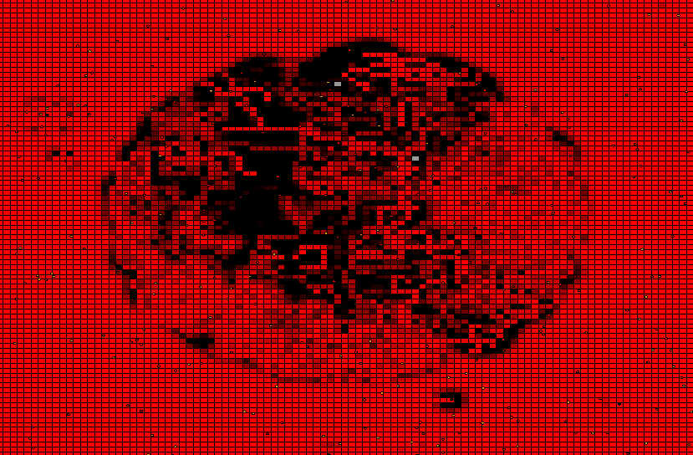
Example: Simulating Oxygen levels in inflammation phase of the wound
Notes:
Hyaluronan (volgens oudere nomenclatuur ook hyaluronzuur of hyaluronaat genoemd) is een glycosaminoglycaan dat veelvuldig in bindweefsel, epitheelweefsel en zenuwweefsel voorkomt. Het is een van de belangrijkste componenten van de extracellulaire matrix, en draagt in belangrijke mate bij aan de celproliferatie en -migratie en is wellicht ook betrokken bij de progressie van sommige tumoren.

Slide 20
Boon et al. 2016 ~ A multi-agent cell-based model for wound contraction
2-Dimensional multi-agent cell-based hybrid model
Contraction (The mechanical pulling of (myo-)fibroblasts on the ECM)
Relevant cell populations:
Leukocytes (to simplify)
Fibroblasts
myofibroblasts
Fibres:
Collagen
Fibrin
Key effector Cytokines/ Chemokines :
tPA
PDGF
TGF-β

Slide 21
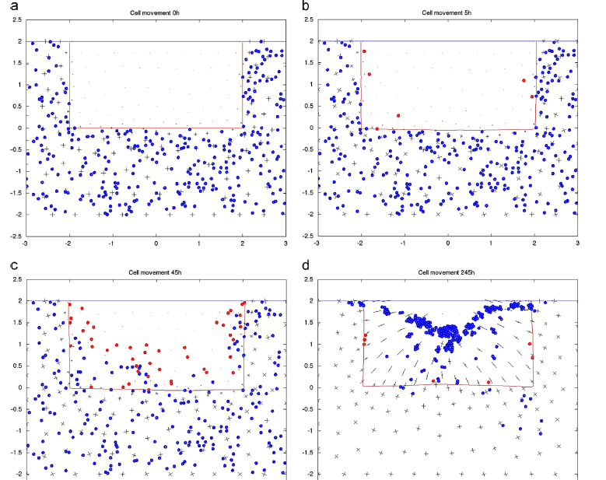
Several snapshots at consecutive times for the leukocytes and fibroblasts that are entering the wound regio.
The red circles -> leukocytes
The blue circles -> fibroblasts
The direction of the lines -> preferential orientation
Notes:
Several snapshots at consecutive times for the leukocytes and fibroblasts that are entering the wound regio.
The red circles indicate the positions of the immune cells, which enter the wound as a result of the gradient of platelet derived growth factor. The blue circles indicate the positions of the fibroblasts, which are lured into thewound area by the gradient of the TGF-β that is secreted by the immune cells.
During the early stages there is front of leukocytes
entering the wound section
followed by the ingress of fibroblasts.
It can also be seen that the wound are a indicated by thered line contracts during the process. In the longer run, the leukocytes and the fibroblasts will die to small numbers at the very end of the simulation. It can be seen that the new collagen that has been deposited by the fibroblasts possesses an oriented structure towards the centre of the wound according to the meaningress of fibroblasts.

Slide 22
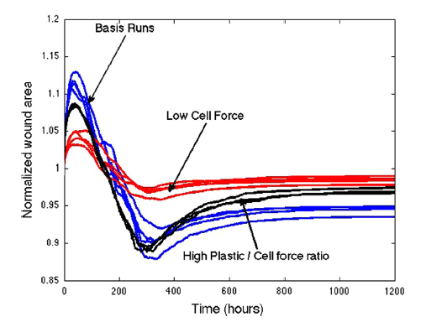
They also tested the influence of ‘Cell Force’ on the normalized wound area
One of the most problematic issues regarding severe burns or deep wounds is the permanent contraction of the wound.
Notes:
Fibroblasts located outside the wounds -> in undamaged tissue so first expands, cause already pulling
Fibroblasts into the wound

Slide 23
Tepole et al. 2017 ~ Computational systems mechanobiology of Wound Healing
2-Dimensional EBM model
Modeling Angiogenesis, Contraction and Re-epithelialization
Relevant cell populations:
Endothelial cells
Macrophages
Fibroblasts
Myofibroblasts
Keratinocytes
Key effector cytokines:
TGF-α
FGF-7
DGF
TGF-β1
FGF(1,2,4)
VEGF
Notes:
Tepole still working on the wound healing

Slide 24

What is the link between the innate immune system model and the wound healing process?
No other papers have modeled this relationship
Several validated models simulate one/two phases of wound healing.
Main difference with cuteanous wounds is the the loss of the skin appendages and re-epithelialization, which can only occur from the edges of the wound
These models only consider the immune system indirectly, while usually explicitly referring to the specific cytokines that activated macrophages release such as TGF-β, TNF-α and interleukins.
Using the same cell populations as the immune system model,
e.g. pro/anti inflammatory cytokines, activated/resting leukocytes, etc.
Essentially, once we have connected the HIIS model to the specific cytokines involved in almost all aspects of the healing process (TGFB,FGF,PDGF, VEGF, TNFa, IL), much of the legwork has been done by these papers.
Integrate the innate immune system model with inflammation
Extend the model for the contraction and remodelling (TU Delft)
Angiogenesis
Notes:
Several of the papers, have validated collagen deposit rates in the presence of inflammatory signals and chemokines, but rely on accurate tissue and blood composition.
Specifically, as far as I can tell, every phase of healing is connected to the immune system but no other papers have modeled this relationship. If we have a validated model connecting AP to any phase of wound healing, is essentially novel research but the inflammation phase is intuitively the best place to start. We should seriously think about how we would be able to validate this though, although the original paper is directly concerned with inflammation (although a different type than that found in wound healing)

Slide 25

Proposal
Discrete Spatio-temporal (existing in both space and time) Agent-Based Model combining both the immune response model and the ABM wound healing models
The HIIS model will act like an engine for the blood composition of a 2-dimensional ABM model.

Slide 26
Approach
Measure which cells and anti- and pro-inflammatory cytokines are in the wound and blood stream(+ concentrations) after a severe burn. (Data probably already available? Cell/Cytokine levels combined with pictures of the wound healing phases.)
Configure and tune our 2D inflammation/contraction ABM using this knowledge
3. Link the ABM to the HIIS model via the cytokine and cell concentrations of the models
How is the inflammation process affected by the balance of cytokines in the bloodstream?
Later, this co-evolution scales with exposure to blood supply, for now leave constant.
Does a 2D model accurately capture dynamics of inflammation/contraction?
Validate the model
From here we can start experimenting and extending further

Slide 27

Data available?
Collecting data will give us a way of assessing what balance of pro and inflammatory cytokines leads to best outcomes.
Age and other socio-markers are important too (e.g. the elderly scar less but heal slower). Several correlations have been established already.
Notes:
We should seriously think about how we would be able to validate this though

Slide 28
 | Immune system | Inflammation | Contraction
Inflammation Triggering Moeties (ITMs) | X
Anti-inflammatory cytokines | X | IL-4 IL-10 IL-1ra
Pro-inflammatory cytokines | X | TNFa IL-8 IL-12 IL-1 IL-6 IFNγ TGFB | tPA PDGF TGFB
Granules | X
Alkaline Phosphatase | X
Macrophages | X | X | X
Neutrophils | X | X | X
Endothelial cells |  | X
T cells (TH0, TH1, TH2) |  | X
Fibroblasts |  |  | X
myofibroblasts |  |  | X
Collagen |  |  | X
Fibrin |  |  | X
Notes:
We should seriously think about how we would be able to validate this though

Slide 29

Cytokine composition of inner and outer areas of wound and in blood stream. | For an integrated model we will need to translate between specific cytokines and the general categories the AP model uses.
TGF-β | Released by macrophages Attracts macrophages and fibroblasts Stimulates resting monocytes – upregulates inflammatory response While also downregulating cytokine production in monocytes and macrophages inhibits activated macrophages
Liver enzymes (AST, ALT) Biochemical Changes in Burns – Adiga et Adiga, 2015 | Excessive levels indicate hepatocytic injury (ALT being the most sensitive indicator). May be predictors of prognosis in burns injury.
Interleukins IL-(1B,6,8,10) | 6 – Found to be the cytokine whose levels predict patient outcome. Correlates with infection/sepsis. Correlates with severity of burn injury. 10-used in design of AP model.
TNF-α | Initiating factor in the activation of the host response and subsequent cytokine release during trauma. Correlates with the severity of burn injury. Pro-angiogenic factor.
Procalcitonin(PCT) & C-reactive protein(CRP) | Sepsis. PCT is the most reliable measure of sepsis. CRP is often used as a general proxy to characterise inflammatory status.
Leptin | Stimulated by pro-inflammatory cytokines (eg IL and TNFa). Cytokine-like hormone that links nutritional status with the immune system, while enhances innate(+adaptive) immunity. Related to regulation of stress. Pro-angiogenic factor.
Full blood Count | Haemoglobin (blood count) White Cell Count (WCC) Platelet Count
Stress biomarkers | Cortisol ACTH TNF-α and IL
Temperature | Wound and body
Matrix metalloproteinase (MMP)-8 | Involved in remodeling process, probably not that useful for now.
Relevant Biomarkers

Slide 30

Relevant parameters/markers
Geometrical Paramaters:
Length
Width
Depth of burn
Surface
Volume
Total Body surface area of burn (TBSA)
Burn Location/s
Body fat %
Tissue scattering, Location of hemoglobin molecules
(High hemoglobin content in the zone of hyperemia)
Macromolecular collagen structure
(native or denatured)
Pigmentation
Relevant Socio-markers
Age
Weight
Height
Gender
Alcohol / Drug use

Slide 31
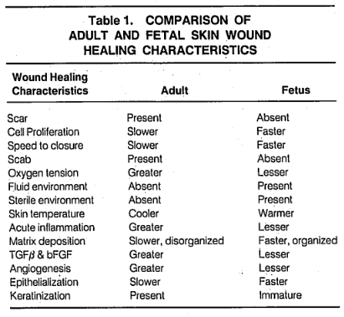
Anti-TGF-β Hypothesis
We (and others) hypothesise that anti-TGF-β therapies later in the healing process may lead to less scarring but slower healing.
Red deer antler (traditional Chinese medicine) ointment found to modulate TGF-β levels and improve cutaneous wound healing outcomes in full-thickness rat models (Gu et al., 2008)
Scarring in adults associated with excessive action of TGF-β
Scarless fetal wounds are relatively deficient in the inflammatory cytokine TGFB (also sparse inflammatory response (reduced macrophage and monocyte infiltrates, absence of endogenous immunoglobulins at the wound site, reduced angiogenesis, and altered levels of peptide growth factors) (Adzick and Lorenz, 1994)
It appears that adult wounds may be optimised for speed of healing under adverse conditions, resulting in excessive inflammatory infiltrate and cytokine profile (Adzick and Lorenz, 1994)
Modulation of AP (through interaction with macrophages) may in fact work in this capacity. (“only” speculation until we validate model).

Slide 32
Planning
week | work
June 10 - June 23 | Finish the conceptualization of the immune-inflammation-contraction 2D ABM (Links between the phases and sketch of interacting cytokines/cells/fibers) Find out what data is necessary to validate/build the model (before next meeting with Paul and Ruud)
June 24 – July 7 | Start modeling/ experimenting with previously built models (in order to link the models). Validating results of previously built models. Hopefully retrieving some data.
July 8 – July 21 | Modellling
22 July – 4 August

